Slide 1


Slide 2

SQLite and Python

Slide 3

SQLite
SQLite is a software library that implements a serverlesst, lightweight SQL database engine.
It is super light with db’s weight less than 400kb.
It is also a package that ships with Python and can be used with python very easily.
Ultimately, it is a RDBMS. the data is in tabular form and their can be relationships between multiple tables.

Slide 4
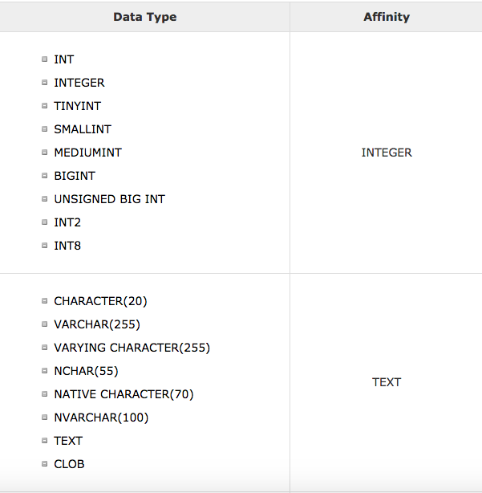
SQLite
Ok, so what type of stuff can be stored? Almost anything.

Slide 5
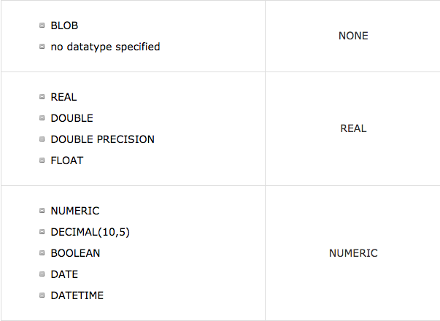
SQLite

Slide 6
Soo.. Let’s create a Database
A database could consist of a single or multuple tables.
Lets start by creating a single table.
In this table, we will have numerical data of different types and along with text data.
Let’s go back to Sublime.
As you can see the structure is column name : Data Type

Slide 7
The two keys
So, what is a primary key? A Primary key uniquely identify a record in the table. It can be made up of multiple columns (composite). It cannot contain null values.
And a foreign key: A foreign key is a field (or collection of fields) in one table that uniquely identifies a row of another table or the same table. In simpler words, the foreign key is defined in a second table, but it refers to the primary key or a unique key in the first table.
Primary keys become foreign keys in other tables, when creating relations among tables.

Slide 8
Database relationships
Types of Relationships
a. One-One Relationship (1-1 Relationship)
Defined as the relationship between two tables where both the tables should be associated with each other based on only one matching row. Can be created using Primary key-Unique foreign key constraints. Created using Primary key-Unique Foreign key relationship.
b. One-Many Relationship (1-M Relationship)
Defined as a relationship between two tables where a row from one table can have multiple matching rows in another table.

Slide 9
Database relationships
c. Many-Many Relationship (M-M Relationship)

Slide 10
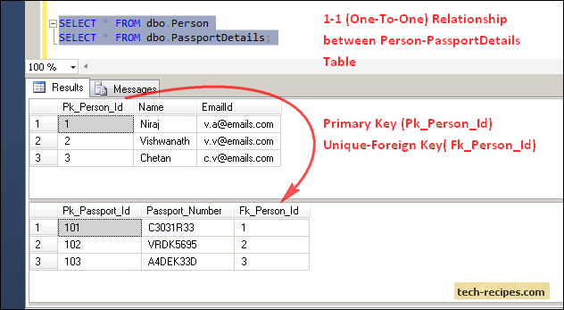
Database relationships

Slide 11
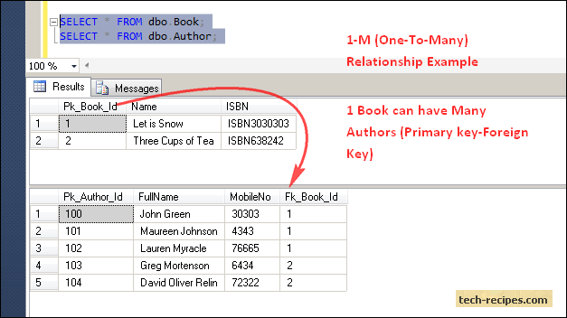
Database relationships

Slide 12
Database relationships

Slide 13
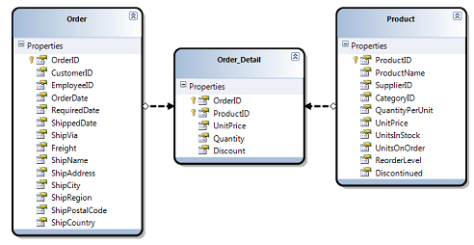
Database relationships: Many-to-Many

Slide 14
JOINS in SQL
SQLite Joins clause is used to combine records from two or more tables in a database. A JOIN is a means for combining fields from two tables by using values common to each.
SQLite supports three joins, CROSS, OUTER, INNER

Slide 15
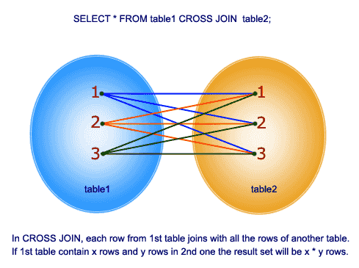
JOINS in SQL
CROSS JOIN matches every row of the first table with every row of the second table. If the input tables have x and y row, respectively, the resulting table will have x*y row

Slide 16
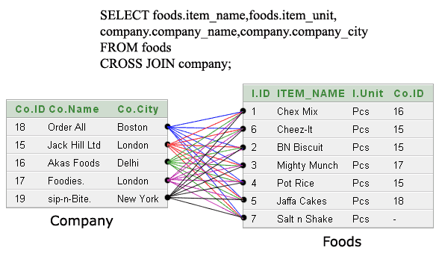
JOINS in SQL

Slide 17

JOINS in SQL
INNER JOIN or JOIN selects the rows that satisfies both the table.
Creates a new result table by combining column values of two tables (table1 and table2) based upon the join-predicate.
SELECT ... FROM table1 [INNER] JOIN table2 ON conditional_expression .

Slide 18
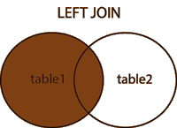
JOINS in SQL
LEFT OUTER JOIN returns all records from the left table (table1), and the matched records from the right table (table2).
The result is NULL from the right side, if there is no match.

Slide 19
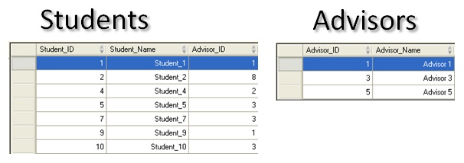
JOINS in SQL
select * from dbo.Students LEFT OUTER JOIN dbo.Advisors ON S.Advisor_ID=A.Advisor_ID

Slide 20
UNIONS in SQL
The UNION operator is used to combine the result-set of two or more SELECT statements.
Each SELECT statement within UNION must have the same number of columns.
The columns must also have similar data types
The columns in each SELECT statement must also be in the same order

Slide 21


